Slide 1
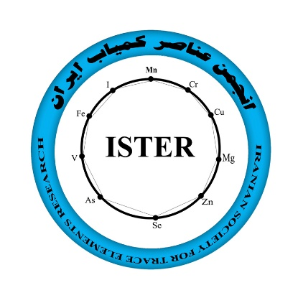
The 6th Iranian Congress of Trace Elements (ICTE 2020) 25-27 February – 2020 |Electrochemical institute- Tehran, Iran|
آرم دانشگاه
شخص ارائه دهنده
Title
first name and last name
Affiliation

Slide 2
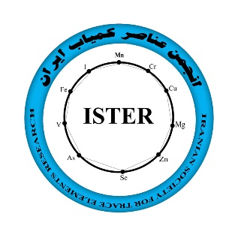
آرم دانشگاه
شخص ارائه دهنده
Dear authors, please use this format to create PowerPoint.
Please email to the secretariat by 2020/2/23.
Thank you.
The 6th Iranian Congress of Trace Elements (ICTE 2020) 25-27 February - 2020| Electrochemical institute- Tehran, Iran |

Slide 3
آرم دانشگاه
شخص ارائه دهنده
Dear authors, please use this format to create PowerPoint.
Please email to the secretariat by 2020/2/23.
Thank you.
The 6th Iranian Congress of Trace Elements (ICTE 2020) 25-27 February - 2020| Electrochemical institute- Tehran, Iran |

Slide 4
آرم دانشگاه
شخص ارائه دهنده
Dear authors, please use this format to create PowerPoint.
Please email to the secretariat by 2020/2/23.
Thank you.
The 6th Iranian Congress of Trace Elements (ICTE 2020) 25-27 February - 2020| Electrochemical institute- Tehran, Iran |

Slide 5
آرم دانشگاه
شخص ارائه دهنده
Dear authors, please use this format to create PowerPoint.
Please email to the secretariat by 2020/2/23.
Thank you.
The 6th Iranian Congress of Trace Elements (ICTE 2020) 25-27 February - 2020| Electrochemical institute- Tehran, Iran |

Slide 6
Thank you

